Slide 1
Developer Experience
Enabling engineers to deliver value
Reduce friction caused by
Tooling
Process & Procedure
Compliance
Apply an engineering and product level approach

Slide 2
Developer Experience
Engineering Labs
Support CI/CD pipelines
Support developer services
Develop & Release Automation

Slide 3
Developer Experience
Small dedicated team
Wide backgrounds
Support deliver of various types of product offerings

Slide 4
Compliance Obligations
Ship only the software you need
Keep your software up-to—date
Open Source Software Compliance

Slide 5
Open Source Software Compliance
OSS exists within a legal framework that creates obligations for the developers and distributors
Not all “open” licenses are as “open” or as “free” as you might think
Recent trend in source available and “open-ish” licenses
Licenses can differ based upon use
SaaS vs traditional software distribution
https://compliance.linuxfoundation.org

Slide 6
How do we meet compliance obligations for containers?

Slide 7
The SBOM is the key!
SBOM – Software Bill of Materials
Complete inventory of ALL components

Slide 8
All components?
1st order
What your product use
2nd order (and greater)
What the 1st order needs to function
Its turtles all the way down

Slide 9
Compliance Challenges
Lack of container support in existing tooling
Container Ecosystem
Unknown content
Unnecessary software
Out-of-date software

Slide 10
Requirements
SBOM Reporting
All components
Vulnerabilities
OSS licenses
Scan & Catalog
Retention based on type
Lifecycle
Integrate with existing Cisco tooling

Slide 11
Approach
Leverage existing tooling for SBOM and vulnerability date
Write middleware to integrate with existing Cisco tooling

Slide 12
Core Container Scanning Solution - Anchore
Opensource & Commercial offerings for scanning images
Anchore Enterprise - https://anchore.com/enterprise
Syft - https://github.com/anchore/syft
Grype - https://github.com/anchore/grype
Various integrations - https://anchore.com/integrations
Able to inventory and monitor numerous types of packages for CVEs
Ubuntu, Debian, CentOS, Alpine, Python, Java, node/NPM, Ruby/Gems
Also supports self-discovery
Rich policy engine that can enforce container best practices

Slide 13
Why we choose Anchore
Clean easy to work with restful API
Accurate SBOM & vulnerability data
Numerous integrations available out of the box
Great support
Fantastic team that really worked with us as partners

Slide 14
Implementation - Helios
In-house restful service for cataloging and reporting on releases
git tags trigger pre-release/release workflow
Release and images added to Helios
Polls Anchore for SBOM, and continually polls for vulnerability data
State management for releases (RC, released, EOL, etc.)
Synchronizes with Cisco internal tooling
SBOM reporting & OSS compliance
Vulnerability management
Real time reporting on SBOM and current vulnerabilities

Slide 15
Implementation - Minerva
In-house service for vulnerability trending and analysis
Real-time & historical reporting on vulnerabilities in releases
Ability to chart release over time and product/component release over release
Pulls SBOM and vulnerability data from Helios and other Cisco internal tools
Integrates with Cisco internal tooling for vulnerability reporting
Automates engineering ticket creation for remediation of vulnerabilities
Image + component + vulnerability
Fix versions
Time to remediation

Slide 16
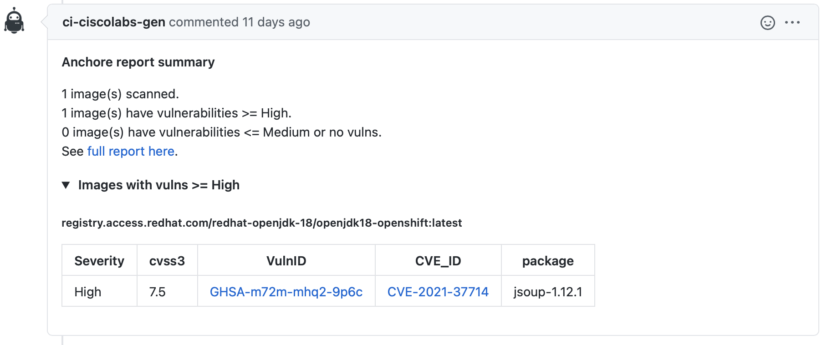
Implementation - PR scanning
Jenkins Plugin - https://plugins.jenkins.io/anchore-container-scanner
In-house wrapper to parse results from Jenkins and post to GitHub PRs
Non-voting, informational only vulnerability report

Slide 17
Next Steps – Helios
Ingesting SBOMs from syft
Better SaaS support (Anchore Kubernetes Runtime Inventory)
SBOM evolution
Executive Order on Improving the Nation’s Cybersecurity
SPDX
CycloneDX

Slide 18
Next Steps – Minerva
Risk based assessment
Vendor dispostion

Slide 19
Next Steps – PR Scanning
Move to syft
Expand to non-container artifacts
Send SBOM to anchore enterprise for vulnerability analysis
Make voting
Add license check

